Slide 1



Leave your C behind:
better embedded library (interfaces) with modern C++
Wouter van Ooijen MSc (ir)
Hogeschool Utrecht, Netherlands,
senior lecturer Computer Engineering
SG14 member
wouter.vanooijen@hu.nl
Notes:
Wouter van Ooijen, if too difficult Woooter will do
Backgroundf Computer Science, passion electronics and hardware/software borderland
Polytechnics
Technical Informatics, small specialization~30-50 std annually
I am NOT working in industry, I guide the next generations into inductry. I hope well prepared

Slide 2
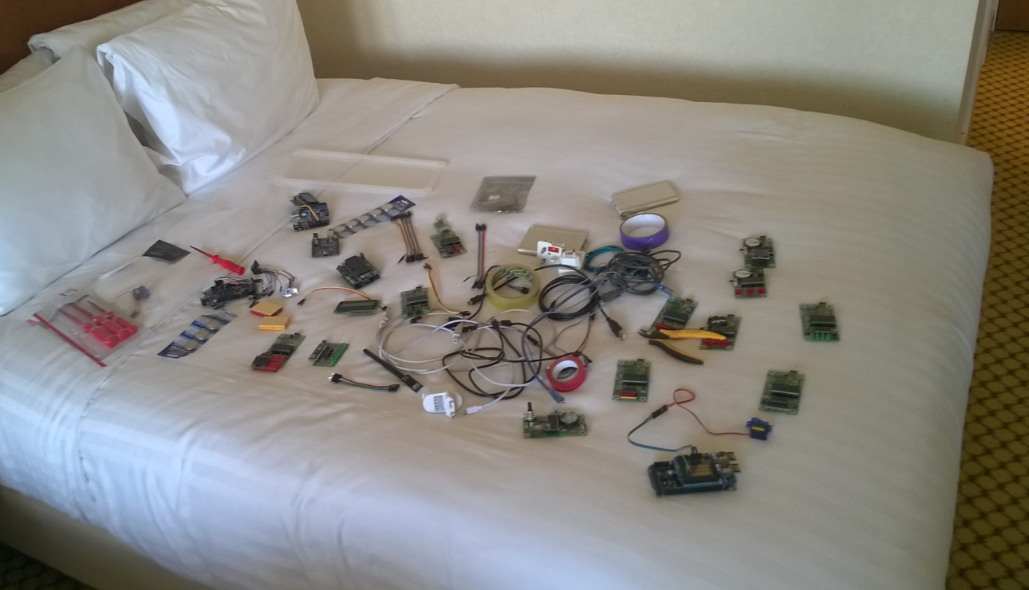

Slide 3
Agenda
Introduction, ‘embedded’
case: NRF24L01
integers, abstraction mechanisms, concepts, GPIO, inversion, SPI, buffering, testing
Demo, takaways, questions

Slide 4
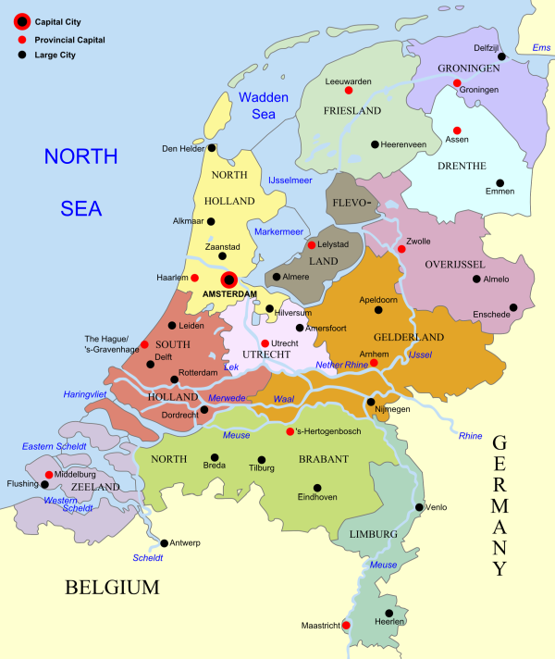
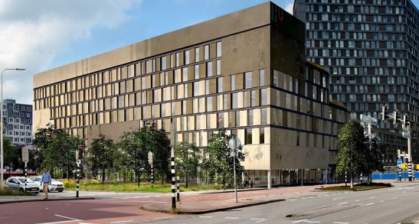
HBO-ICT

Slide 5
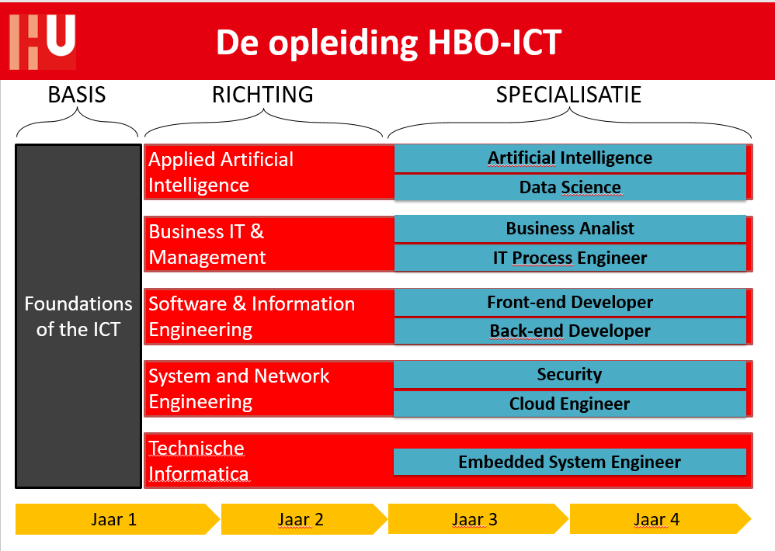
~ 400/y
~ 60/y

Slide 6
HBO-ICT TI/embedded focus
resource-constrained programming
embedded
(small) micro-controllers
“arduino programming, but professionally”

Slide 7


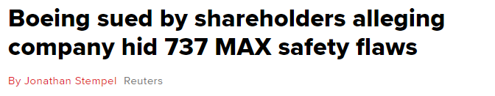
Personal compass
When my children fly in a plane programmed by one of my former students, I want to sleep without worries.

Slide 8
embedded

Slide 9
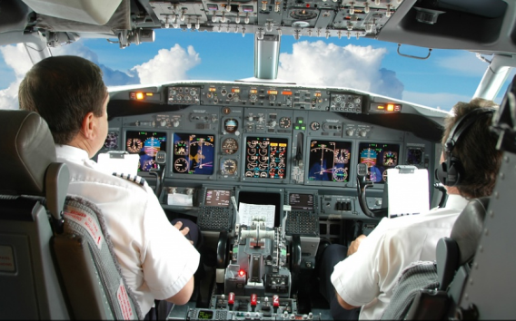

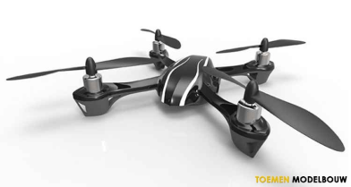
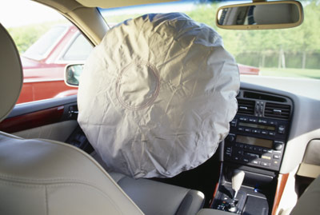

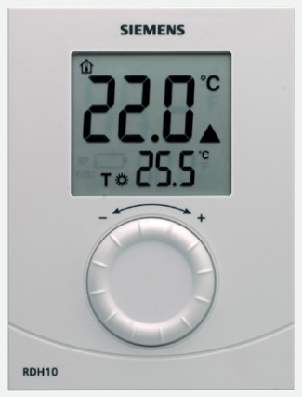
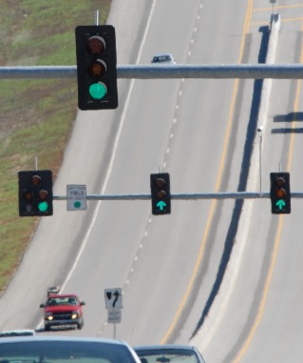
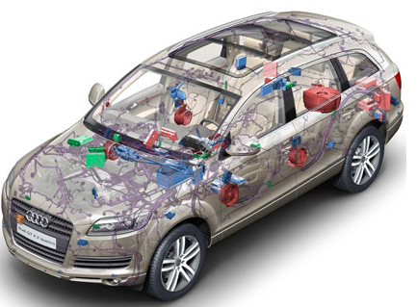


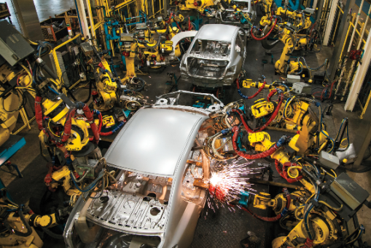
Wide span of seriousness
fun
deadly serious

Slide 10
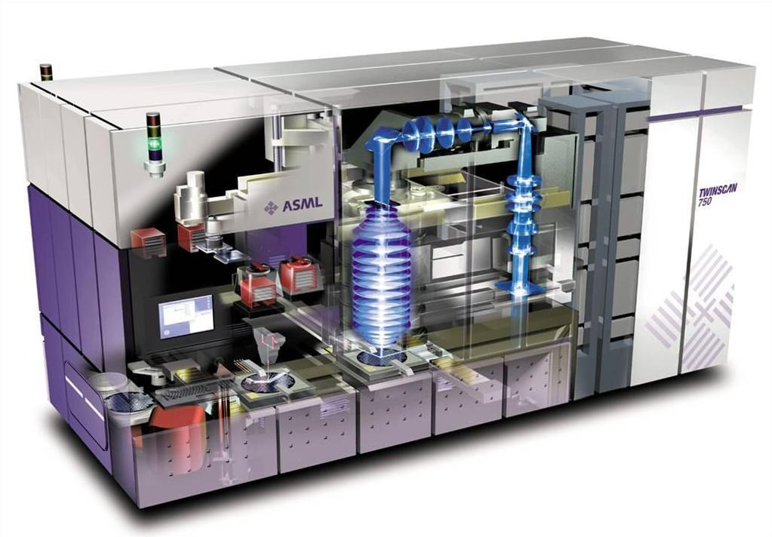
Wide span of response time
µs
ms
s

Slide 11
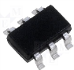
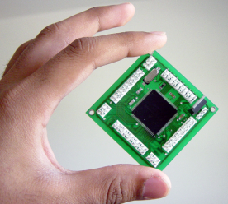
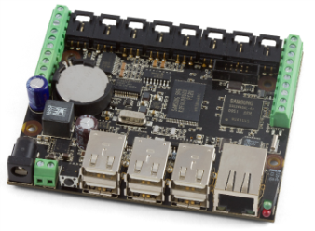
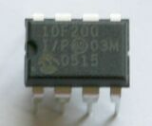
Wide span of hardware
1KiB
1MiB
1GiB
4-bit
64-bit
8-bit : 8051, PIC, AVR, …
No full standard C/C++
16-bit : MSP430, PIC, …
32-bit : ARM, MIPS, Tensilca, Intel, …

Slide 12

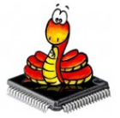


Wide span of support software
1KiB
1MiB
1GiB
Bare metal:
libraries
no separate OS
Desktop OS:
Linux
Windows
Interpreter
RTOS

Slide 13
fast trading
gaming
MiB, GiB
GHz, multi-core
Memory latency, caches
simulation
large-embedded
bytes, KiB
MHz, Interrupts
Hardware peripherals
Battery life-time
small-embedded

Slide 14
‘my’ embedded
1KiB
1MiB
1GiB
Bare metal, no (separate) OS
Kb RAM and ROM (not Mb)

Slide 15
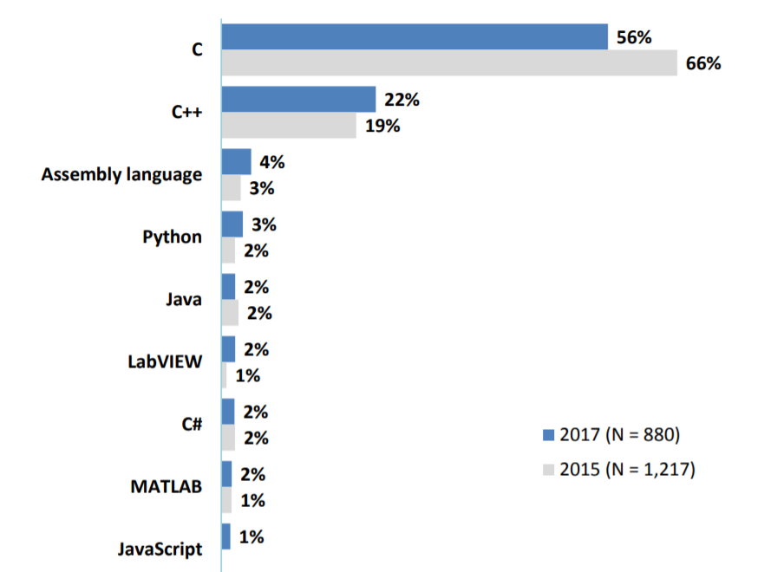
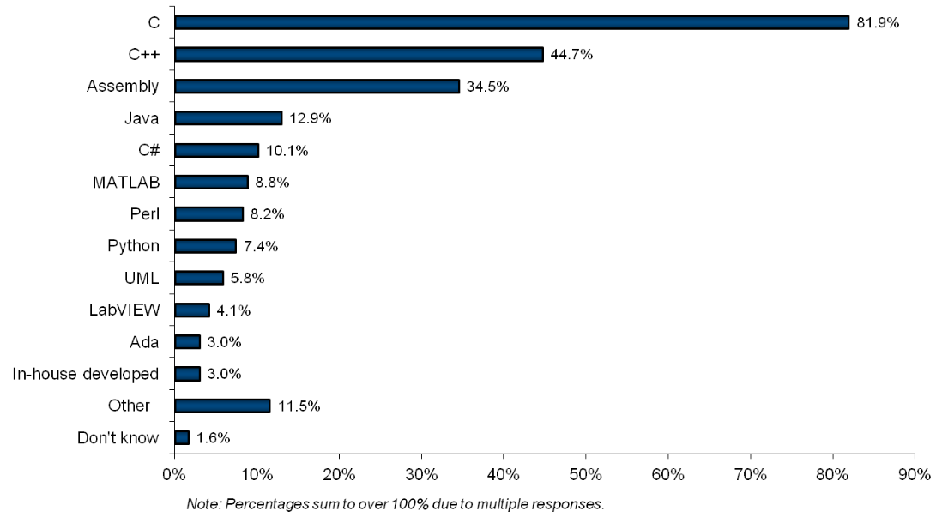
Embedded languages
Probably not my type of embedded

Slide 16
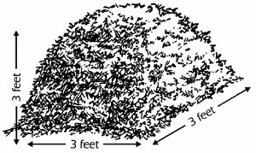

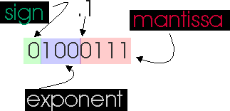
I use C++, but maybe not as you use it
(probably) avoid:
RTTI
the heap (free store), hence
exceptions
standard containers (except std::array<>)
floating point

Slide 17
NRF24L01

Slide 18

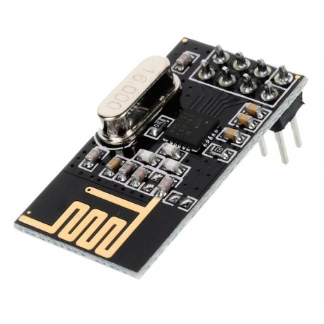
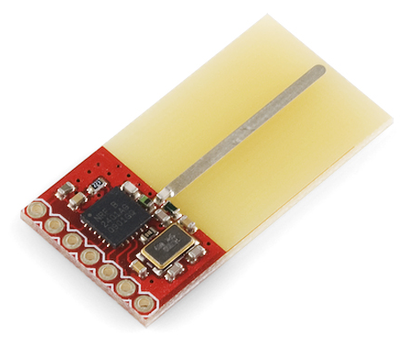
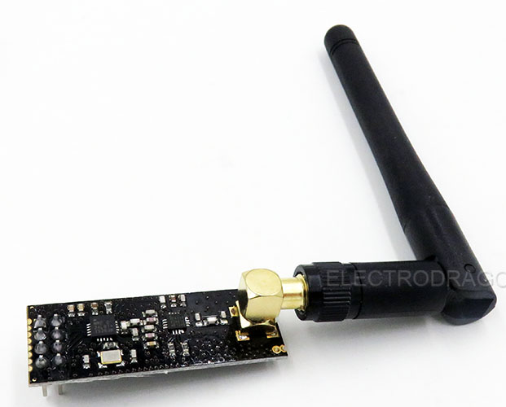
2.4 GHz transceiver
short range
cheap
wireless peripherals (mouse, headset, sensor, toy, …)
variations (NRF2401, NRF24L01+), clones (RMF73)

Slide 19
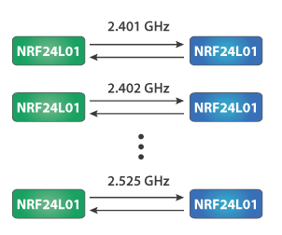
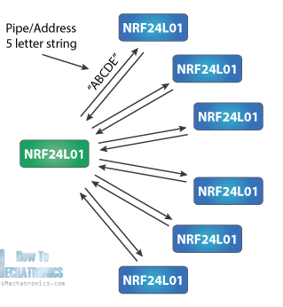

128 frequency bands
1 or 2 MHz (air) data rate
1..32 byte messages
0/1/2 byte CRC
1:1 or 1:n
datagram or ack/retry
0..5 byte addresses
6 receive addresses

Slide 20
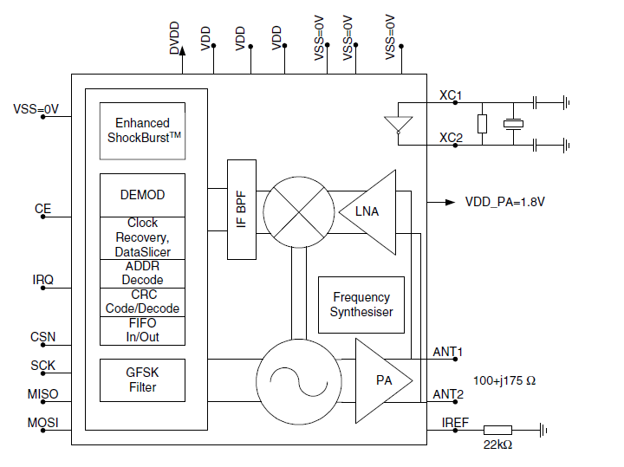
3.3V (5V tolerant IO)
1uA .. 10 mA
SPI
CE

Slide 21
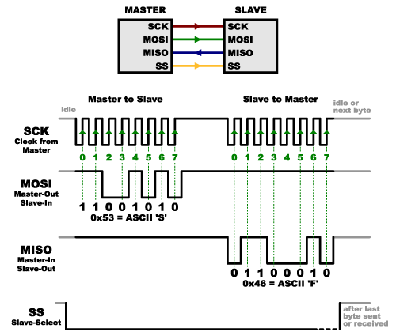
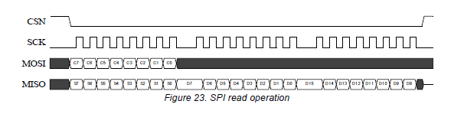
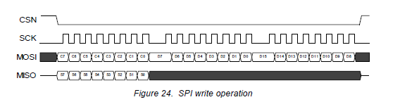
Multi-byte, variable length SPI operations
byte 1: command ➔; ⬅ status
bytes >1 : either read or write, depends on command

Slide 22
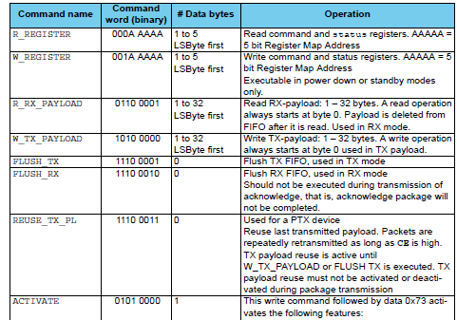
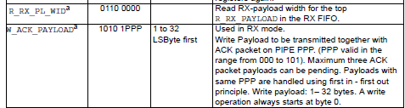
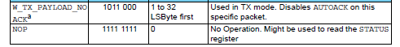
SPI commands

Slide 23
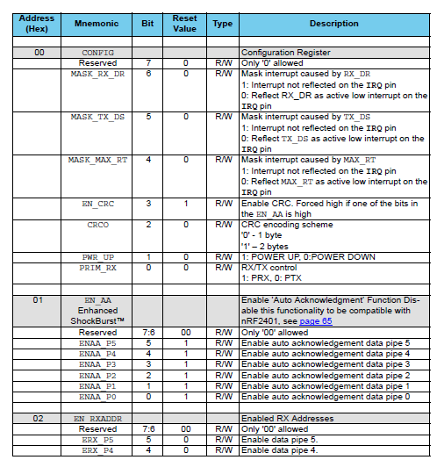
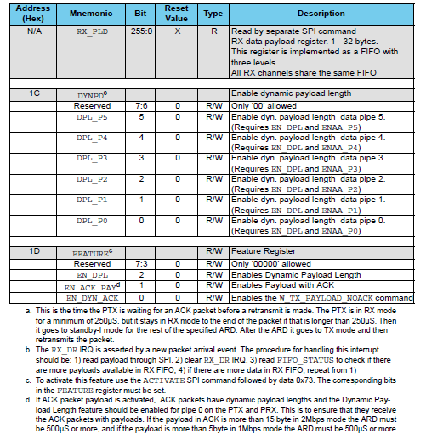
Registers
. . .
7 pages, 26 registers

Slide 24
user
NRF24L01
SPI
GPIO
Timing
Hardware Abstraction Layer (HAL)
https://github.com/wovo/godafoss
https://github.com/wovo/bmtk
microcontroller chip hardware

Slide 25
nrf24l01.hpp
https://github.com/wovo/godafoss/library/chips/nrf24l01.hpp

Slide 26
1
// ==========================================================================
//
// file : gf-nrf24l01.hpp
//
// ==========================================================================
template< size_t n > concept bool range_1_5 =
( ( n > 0 ) && ( n < 6 ) );
template< size_t n > concept bool range_1_32 =
( ( n > 0 ) && ( n < 33 ) );
template<
typename _bus, // SPI bus (MOSI, MISO, SCK)
can_pin_out _ce, // CE (Chip Enable) pin
can_pin_out _csn, // SPI Chip Select (Negative) pin
typename timing // timing service
>
struct nrf24l01_spi_ce_csn {
using bus = _bus;
using chip_enable = direct< pin_out< _ce >>;
using chip_select = invert< direct< pin_out< _csn >>>;
static void init(){
bus::init();
chip_enable::init();
chip_select::init();
chip_enable::write( 0 );
chip_select::write( 0 );
timing::init();
timing:: template ms< 50 >::wait();
}

Slide 27
2
// ========================================================================
// commands
// ========================================================================
enum class cmd : uint8_t {
read_reg = 0x00, // read a register
write_reg = 0x20, // write a register
r_rx_payload = 0x61, // read a received payload
w_tx_payload = 0xa0, // write a payload to be sent
flush_tx = 0xe1, // empty the transmit queue
flush_rx = 0xe2, // empty the receive queue
reuse_tx_pl = 0xe3, // start continuous retransmission
activate = 0x50, // toggle extended functions
r_rx_pl_wid = 0x60, // read length of fifo head payload
w_ack_payload = 0xa8, // write payload to be transmitted with ack
w_tx_payload_noack = 0xb0, // write payload to be sent without auto-ack
nop = 0xff // no action, can be used to read the status
};
using bus_transfer = typename bus:: template transfer< chip_select >;

Slide 28
3
static void write( const cmd c ){
bus_transfer().write( static_cast< uint8_t>( c ) );
}
static void write( const cmd c, const uint8_t d ){
auto t = bus_transfer();
t.write( static_cast< uint8_t>( c ) );
t.write( d );
}
template< range_1_32 n >
static void write(
const cmd c,
const std::array< uint8_t, n > & d,
int_fast16_t amount = n
){
auto t = bus_transfer();
t.write( static_cast< uint8_t>( c ) );
t.write( d, amount );
}
template< range_1_32 n >
static void read(
const cmd c,
std::array< uint8_t, n > & d,
const int_fast16_t amount = n
){
auto t = bus_transfer();
t.write( static_cast< uint8_t>( c ) );
t.read( d, amount );
}

Slide 29
4
// ========================================================================
// registers
// ========================================================================
enum class reg : uint8_t {
config = 0x00, // configuration register
en_aa = 0x01, // enable auto ack on pipes
en_rxaddr = 0x02, // enable receive pipes
setup_aw = 0x03, // set address length
setup_retr = 0x04, // retransmission settings
rf_ch = 0x05, // rf channel (frequency)
rf_setup = 0x06, // data rate, transmit power, lna
status = 0x07, // status register
observe_tx = 0x08, // lost and retransmitted packets
cd = 0x09, // carrier detect
rx_addr_p0 = 0x0a, // receive address pipe 0, 5 bytes
rx_addr_p1 = 0x0b, // receive address pipe 1, 5 bytes
rx_addr_p2 = 0x0c, // receive address pipe 2, 1 byte
rx_addr_p3 = 0x0d, // receive address pipe 2, 1 byte
rx_addr_p4 = 0x0e, // receive address pipe 2, 1 byte
rx_addr_p5 = 0x0f, // receive address pipe 2, 1 byte
tx_addr = 0x10, // transmit adress, 5 bytes
rx_pw_p0 = 0x11, // number of bytes in pipe 0 package
rx_pw_p1 = 0x12, // number of bytes in pipe 1 package
rx_pw_p2 = 0x13, // number of bytes in pipe 2 package
rx_pw_p3 = 0x14, // number of bytes in pipe 3 package
rx_pw_p4 = 0x15, // number of bytes in pipe 4 package
rx_pw_p5 = 0x16, // number of bytes in pipe 5 package
fifo_status = 0x17, // receive and transmit fifo status (RO)
dynpd = 0x1c, // dynamic payload flags
feature = 0x1d // special features flags
};

Slide 30
5
// compose command to read or write a register
static constexpr uint8_t compose( const cmd c, const reg r ){
return
static_cast< uint8_t >( c )
| static_cast< uint8_t >( r );
}
// status register bit-field masks
static const uint8_t status_rx_dr = 0b0'0100'0000;
static const uint8_t status_tx_ds = 0b0'0010'0000;
static const uint8_t status_max_rt = 0b0'0001'0000;
static const uint8_t status_tx_full = 0b0'0000'0001;
// fifo_status register bit-field masks
static const uint8_t fifo_status_tx_reuse = 0b0'0100'0000;
static const uint8_t fifo_status_tx_full = 0b0'0010'0000;
static const uint8_t fifo_status_tx_empty = 0b0'0001'0000;
static const uint8_t fifo_status_rx_full = 0b0'0000'0010;
static const uint8_t fifo_status_rx_empty = 0b0'0000'0001;

Slide 31
6
static uint_fast8_t read( const reg r ){
auto t = bus_transfer();
t.write( compose( cmd::read_reg, r ) );
return t.read_byte();
}
template< size_t n >
static void read( const reg r, std::array< uint8_t, n > & d ){
auto t = bus_transfer();
t.write( compose( cmd::read_reg, r ) );
t.read( d );
}
static void write( const reg r, uint8_t d ){
auto t = bus_transfer();
t.write( compose( cmd::write_reg, r ) );
t.write( d );
}
template< size_t n >
static void write( const reg r, const std::array< uint8_t, n > & d ){
auto t = bus_transfer();
t.write( compose( cmd::write_reg, r ) );
t.write( d );
}

Slide 32
7
// ========================================================================
// basic functionality
// ========================================================================
// ========= status register
static uint_fast8_t status(){
return read( reg::status );
}
static void interrupts_clear(){
write( reg::status, read( reg::status ) );
}
enum class crc : uint8_t {
none = 0b0'0000,
one_byte = 0b0'1000,
two_bytes = 0b0'1100
};
static void configure( const crc x ){
write(
reg::config,
( read( reg::config ) & 0xF3 )
| static_cast< uint8_t>( x ) );
}

Slide 33
8
// ========= en_aa register
static void pipe_autoack( const bool enabled ){
write( reg::en_aa, enabled ? 0x3F : 0x00 );
}
static void pipe_autoack( const uint_fast8_t pipe, const bool enabled ){
if( pipe <= 5 ){
uint8_t val = read( reg::en_aa );
if( enabled ){
val |= 1 << pipe;
} else {
val &= ~ ( 1 << pipe );
}
write( reg::en_aa, val );
}
}
. . .

Slide 34
9
// ========================================================================
// high-level (use cases) interface
// ========================================================================
static void mode_receive(){
chip_enable::write( 0 );
// switch to receive mode
uint8_t value = read( reg::config );
value |= 0x01; // set RX bit
value |= 0x02; // set PWR_UP bit
write( reg::config, value );
// flush receive queue
write( cmd::flush_rx );
interrupts_clear();
chip_enable::write( 1 );
timing:: template us< 130 >::wait();
}
static void mode_transmit(){
chip_enable::write( 0 );
// switch to transmit mode
uint8_t value = read( reg::config );
value &= 0xFE; // clear RX bit
value |= 0x02; // set PWR_UP bit
write( reg::config, value );
chip_enable::write( 1 );
// flush transmit queue
write( cmd::flush_tx );
interrupts_clear();
}

Slide 35
10
struct air_configuration {
channel ch;
rate adr;
crc c;
power pwr;
lna l;
address_length al;
};
static void configure( const air_configuration & conf ){
chip_enable::write( 0 );
configure( conf.ch );
configure( conf.adr );
configure( conf.c );
configure( conf.pwr );
configure( conf.l );
configure( conf.al );
}

Slide 36

Integers

Slide 37
Don’t use naked int types
Specific types | Use for
int_fast8_t, uint_fast8_t int_fast16_t, uint_fast16_t int_fast32_t, uint_fast32_t int_fast64_t, uint_fast64_t | Passing a value around quickly (variables, function parameters, return values) Compile chooses the fastest option (64: 16->64)
int_least8_t, uint_least8_t int_least16_t, uint_least16_t int_least32_t, uint_least32_t int_least64_t, uint_least64_t | Storing a value when size matters (more than CPU speed, or always?) (large arrays) Compiler chooses the exact or next-larger option (no 16? 16->32)
int8_t, uint8_t int16_t, uint16_t int32_t, uint32_t int64_t, uint64_t | Forcing a fixed size (layout in memory) Compiler must use the exact size (no 16? uint16_t fails)

Slide 38
Signed or unsigned?
Flavour | For | Literals
signed | Counting things Value arithmetic | Decimal
unsigned | Bit patterns Bitwise arithmetic | Hex or binary
char | ASCII characters | ‘a’

Slide 39
Be sign-correct
uint8_t n = 12;
n++;
int8_t x = 0x12;
x |= 0x03;
int_fast8_t
uint_fast8_t
signed for value- (arithmetic-) types
unsigned for bit- (arithmetic-) types

Slide 40
Be size-correct
for( int i = 0; i < 8; ++i ) . . .
void wait_ms( int n );
wait_ms( 50’000 );
int_fast8_t
int_fast32_t
specify the number of bits you need

Slide 41
Be purpose-correct
for( int16_t i = 0; i < 50’000; ++i {
. . .
};
uint_fast16_t
in most cases, allow a larger type

Slide 42
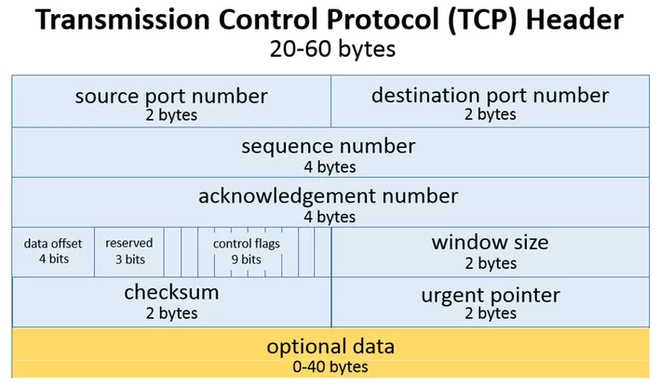
Be purpose-correct
struct ip_header {
short int port_number;
. . .
};
uint16_t
use the fixed-size types (only) for fixing a layout

Slide 43
Be purpose-correct
uint16_t big_array_of_counts[ 10’000 ];
uint_least16_t
use the ‘least’ when memory size is critical

Slide 44
Be const-correct
void f( char * p );
f( ”Hi there” );
const char *
leave your C heritage behind

Slide 45
Be const-eager
void print( some_large_type & p );
const some_large_type &
what can be const must be const

Slide 46
Integers are easy! ☺
Just be
sign-correct
size-correct
purpose-correct
const-correct and const-eager

Slide 47
Abstraction
-
Configuration

Slide 48


Library code needs to be made more specific before use
Tailoring
Configuration
Dependency injection
Parmeterization
Construction (one-phase or two-phase)

Slide 49
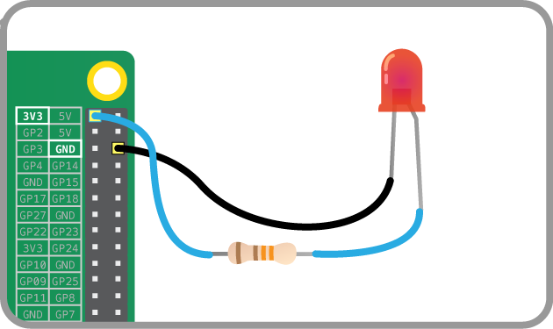
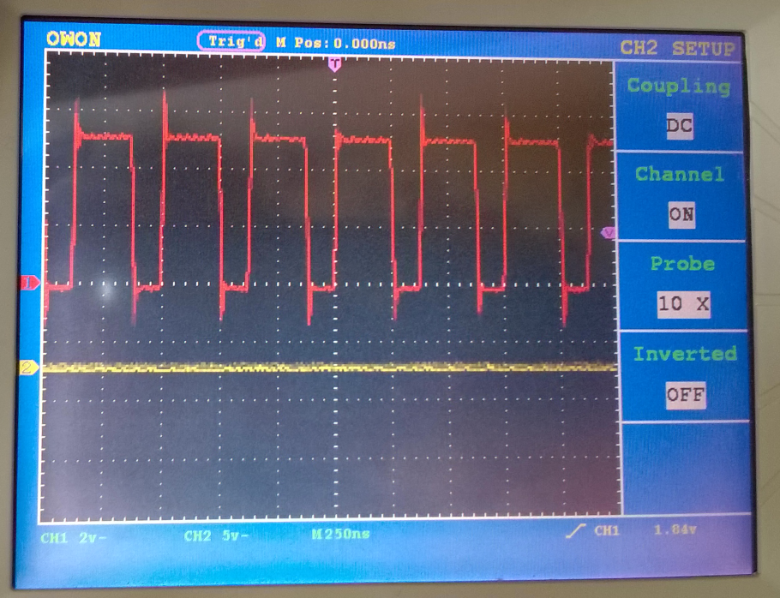
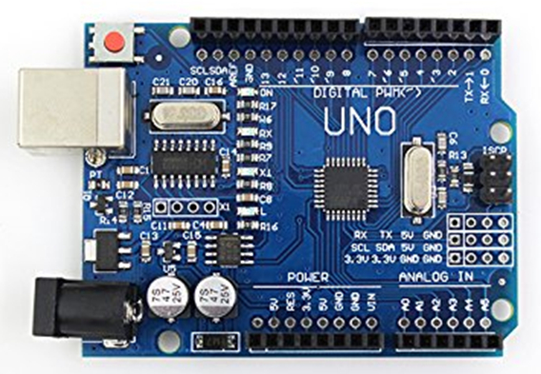
Blink a LED (as fast as we can)

Slide 50
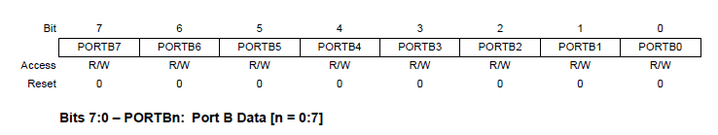
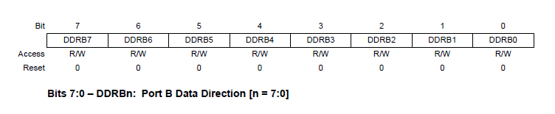
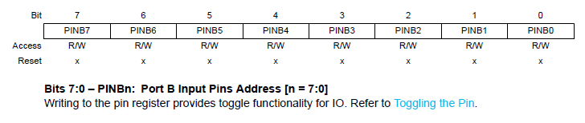
atMega328 (Arduino Uno)

Slide 51
Toggle
void toggle(){
for(;;){
PORTB &= ~( 0b01 << 5 );
PORTB |= ( 0b01 << 5 );
}
}
int main( void ){
DDRB |= ( 0b01 << 5 );
toggle();
}
00000080 <_Z6togglev>:
2d 98 cbi 0x05, 5
2d 9a sbi 0x05, 5
fd cf rjmp .-6

Slide 52
375 ns
00000080 <_Z6togglev>:
2d 98 cbi 0x05, 5
2d 9a sbi 0x05, 5
fd cf rjmp .-6
16 MHz
62.5 ns/clock cycle
3 instr * 2 cycles
6 * 62.5 ns = 350 ns

Slide 53
Configuration mechanisms
void toggle(){
for(;;){
PORTB &= ~( 0b01 << 5 );
PORTB |= ( 0b01 << 5 );
}
}
Edit the source
Macro’s
Global things
Parameters (functions, identifiers)
OO : object parameters
Template parameters

Slide 54
Use PORT/PIN macros
// toggle.hpp
void toggle(){
for(;;){
PORT &= ~( 0b01 << PIN );
PORT |= ( 0b01 << PIN );
}
}
#define PORT PORTB
#define DDR DDRB
#define PIN 5
#include ”toggle.hpp”
int main( void ){
DDR |= ( 0b01 << PIN );
toggle();
}
375 ns
00000080 <_Z6togglev>:
2d 98 cbi 0x05, 5
2d 9a sbi 0x05, 5
fd cf rjmp .-6

Slide 55
Use a SET macro
// toggle.hpp
// in some library file
void toggle(){
for(;;){
PORTB &= ~( 0b01 << 5 );
PORTB |= ( 0b01 << 5 );
}
}
#define PIN_SET( x ) \
if( x ){ \
PORTB &= ~( 0b01 << 5 ); \
} else { \
PORTB |= ( 0b01 << 5 ); \
}
#include ”toggle.hpp”
int main( void ){
DDRB |= ( 0b01 << 5 );
toggle();
}
375 ns
00000080 <_Z6togglev>:
2d 98 cbi 0x05, 5
2d 9a sbi 0x05, 5
fd cf rjmp .-6

Slide 56
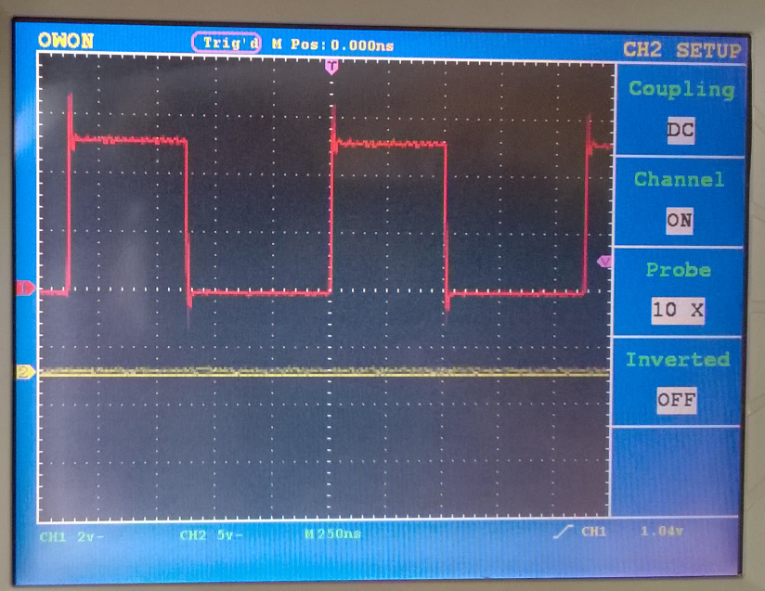
Use a set function
1125 ns
// toggle.cpp
void toggle(){
for(;;){
pin_set( 1 );
pin_set( 0 );
}
}
00000080 <_Z7pin_setb>:
88 23 and r24, r24
11 f0 breq .+4
2d 98 cbi 0x05, 5
08 95 ret
2d 9a sbi 0x05, 5
08 95 ret
0000008c <_Z6togglev>:
2d 98 cbi 0x05, 5
80 e0 ldi r24, 0x00
0e 94 40 00 call 0x80
fb cf rjmp .-10
void pin_set( bool x ){
if( x ){
PORTB &= ~( 0b01 << 5 );
} else {
PORTB |= ( 0b01 << 5 );
}
}
void toggle();
int main( void ){
DDRB |= ( 0b01 << 5 );
toggle();
}

Slide 57
Use an inline set function
// toggle.inc
void toggle(){
for(;;){
pin_set( 1 );
pin_set( 0 );
}
}
__attribute__((always_inline))
void pin_set( bool x ) {
if( x ){
PORTB &= ~( 0b01 << 5 );
} else {
PORTB |= ( 0b01 << 5 );
}
}
#include ”toggle.inc”
int main( void ){
DDRB |= ( 0b01 << 5 );
toggle();
}
375 ns
00000080 <_Z6togglev>:
2d 98 cbi 0x05, 5
2d 9a sbi 0x05, 5
fd cf rjmp .-6

Slide 58
Use function parameter
1’800 ns
// toggle.cpp
void toggle( void(*f)(bool) ){
for(;;){
f( 1 );
f( 0 );
}
}
00000080 <_Z7pin_setb>:
88 23 and r24, r24
11 f0 breq .+4
2d 98 cbi 0x05, 5 ; 5
08 95 ret
2d 9a sbi 0x05, 5 ; 5
08 95 ret
0000008c <_Z6togglePFvbE>:
ec 01 movw r28, r24
81 e0 ldi r24, 0x01
fe 01 movw r30, r28
09 95 icall
80 e0 ldi r24, 0x00
fe 01 movw r30, r28
09 95 icall
f9 cf rjmp .-14
void pin_set( bool x ) {
if( x ){
PORTB &= ~( 0b01 << 5 );
} else {
PORTB |= ( 0b01 << 5 );
}
}
void toggle( void(*f)(bool) );
int main( void ){
DDRB |= ( 0b01 << 5 );
toggle( pin_set );
}

Slide 59
Use identifier parameter
// toggle.cpp
void toggle( int p ){
for(;;){
pin_set( p, 1 );
pin_set( p, 0 );
}
}
void pin_set( int p, bool v ) {
if( p < 10 ){
} else if( p < 20 ){
if( v ){
PORTB &= ~( 0b01 << ( p % 10 ));
} else {
PORTB |= ( 0b01 << ( p % 10 ) );
}
} else if( p < 30 ){
if( v ){
PORTC &= ~( 0b01 << ( p % 10 ) );
} else {
PORTC |= ( 0b01 << ( p % 10 ) );
}
}
}
int main( void ){
DDRB |= ( 0b01 << 5 );
toggle( 15 );
}
000000ec <_Z6togglei>:
ec 01 movw r28, r24
61 e0 ldi r22, 0x01
ce 01 movw r24, r28
0e 94 40 00 call 0x80
60 e0 ldi r22, 0x00
ce 01 movw r24, r28
0e 94 40 00 call 0x80
f7 cf rjmp .-18

Slide 60
Use identifier parameter
35’000 ns
void pin_set( int p, bool v ) {
if( p < 10 ){
} else if( p < 20 ){
if( v ){
PORTB &= ~( 0b01 << ( p % 10 ));
} else {
PORTB |= ( 0b01 << ( p % 10 ) );
}
} else if( p < 30 ){
if( v ){
PORTC &= ~( 0b01 << ( p % 10 ) );
} else {
PORTC |= ( 0b01 << ( p % 10 ) );
}
}
}
int main( void ){
DDRB |= ( 0b01 << 5 );
toggle( 15 );
}
00000080 <_Z7pin_setib>:
80: 46 2f mov r20, r22
82: 8a 30 cpi r24, 0x0A ; 10
84: 91 05 cpc r25, r1
86: 7c f1 brlt .+94 ; 0xe6 <_Z7pin_setib+0x66>
88: 84 31 cpi r24, 0x14 ; 20
8a: 91 05 cpc r25, r1
8c: b4 f4 brge .+44 ; 0xba <_Z7pin_setib+0x3a>
8e: 6a e0 ldi r22, 0x0A ; 10
90: 70 e0 ldi r23, 0x00 ; 0
92: 0e 94 85 00 call 0x10a ; 0x10a <__divmodhi4>
96: 21 e0 ldi r18, 0x01 ; 1
98: 30 e0 ldi r19, 0x00 ; 0
9a: b9 01 movw r22, r18
9c: 02 c0 rjmp .+4 ; 0xa2 <_Z7pin_setib+0x22>
9e: 66 0f add r22, r22
a0: 77 1f adc r23, r23
a2: 8a 95 dec r24
a4: e2 f7 brpl .-8 ; 0x9e <_Z7pin_setib+0x1e>
a6: cb 01 movw r24, r22
a8: 95 b1 in r25, 0x05 ; 5
aa: 44 23 and r20, r20
ac: 21 f0 breq .+8 ; 0xb6 <_Z7pin_setib+0x36>
ae: 80 95 com r24
b0: 89 23 and r24, r25
b2: 85 b9 out 0x05, r24 ; 5
b4: 08 95 ret
b6: 89 2b or r24, r25
b8: fc cf rjmp .-8 ; 0xb2 <_Z7pin_setib+0x32>
ba: 8e 31 cpi r24, 0x1E ; 30
bc: 91 05 cpc r25, r1
be: 9c f4 brge .+38 ; 0xe6 <_Z7pin_setib+0x66>
c0: 6a e0 ldi r22, 0x0A ; 10
c2: 70 e0 ldi r23, 0x00 ; 0
c4: 0e 94 85 00 call 0x10a ; 0x10a <__divmodhi4>
c8: 21 e0 ldi r18, 0x01 ; 1
ca: 30 e0 ldi r19, 0x00 ; 0
cc: b9 01 movw r22, r18
ce: 02 c0 rjmp .+4 ; 0xd4 <_Z7pin_setib+0x54>
d0: 66 0f add r22, r22
d2: 77 1f adc r23, r23
d4: 8a 95 dec r24
d6: e2 f7 brpl .-8 ; 0xd0 <_Z7pin_setib+0x50>
d8: cb 01 movw r24, r22
da: 98 b1 in r25, 0x08 ; 8
dc: 44 23 and r20, r20
de: 21 f0 breq .+8 ; 0xe8 <_Z7pin_setib+0x68>
e0: 80 95 com r24
e2: 89 23 and r24, r25
e4: 88 b9 out 0x08, r24 ; 8
e6: 08 95 ret
e8: 89 2b or r24, r25
ea: fc cf rjmp .-8 ; 0xe4 <_Z7pin_setib+0x64>

Slide 61
OO : object parameter
class pin {
public:
virtual void set( bool v ) = 0;
};
void toggle( pin & p ){
for(;;){
p.set( 1 );
p.set( 0 );
}
}
class pin_b5 : public pin {
public:
pin_b5(){
DDRB |= ( 0b01 << 5 );
}
void set( bool v ) override {
if( v ){
PORTB &= ~( 0b01 << 5 );
} else {
PORTB |= ( 0b01 << 5 );
}
}
};
int main( void ){
pin_b5 p;
toggle( p );
}

Slide 62
OO : object parameter
3’000 ns
void toggle( pin & p ){
for(;;){
p.set( 1 );
p.set( 0 );
}
}
class pin_b5 : public pin {
public:
. . .
void set( bool v ) override {
if( v ){
PORTB &= ~( 0b01 << 5 );
} else {
PORTB |= ( 0b01 << 5 );
}
}
};
000000a2 <_Z6toggleR3pin>:
ec 01 movw r28, r24
e8 81 ld r30, Y
f9 81 ldd r31, Y+1
01 90 ld r0, Z+
f0 81 ld r31, Z
e0 2d mov r30, r0
61 e0 ldi r22, 0x01
ce 01 movw r24, r28
09 95 icall
e8 81 ld r30, Y
f9 81 ldd r31, Y+1
01 90 ld r0, Z+
f0 81 ld r31, Z
e0 2d mov r30, r0
60 e0 ldi r22, 0x00
ce 01 movw r24, r28
09 95 icall
ef cf rjmp .-34
00000096 <_ZN6pin_b53setEb>:
66 23 and r22, r22
11 f0 breq .+4
2d 98 cbi 0x05, 5
08 95 ret
2d 9a sbi 0x05, 5
08 95 ret

Slide 63
Template
template< typename P >
void toggle(){
P::init();
for(;;){
P::set( 1 );
P::set( 0 );
}
}
class pin_b5 {
public:
static void init(){
DDRB |= ( 0b01 << 5 );
}
static void set( bool v ){
if( v ){
PORTB &= ~( 0b01 << 5 );
} else {
PORTB |= ( 0b01 << 5 );
}
}
};
250 ns
00000080 <main>:
25 9a sbi 0x04, 5
2d 98 cbi 0x05, 5
2d 9a sbi 0x05, 5
fd cf rjmp .-6
int main( void ){
toggle< pin_b5 >();
}

Slide 64
Configuration mechanisms
Mechanism | Run-Time | Multiple? | Toggle cycle (ns)
Edit the code | - | - | 375
Global set function | - | - | 1’125
Idem, inline | - | - | 375
Function (function-) parameter | Y | Y | 1’800
Identifier (function-) parameter | Y | Y | 35’000
Object (function-) parameter | Y | Y | 3’000
Class (template) parameter | - | Y | 375

Slide 65
Concepts

Slide 66
Pass ‘things’ around as template parameters
class pin_b5 {
public:
static void set( bool v ){ . . . }
};
template< typename P >
void toggle(){
for(;;){
P::set( 1 );
P::set( 0 );
}
}
int main( void ){
toggle< pin_b5 >();
}

Slide 67
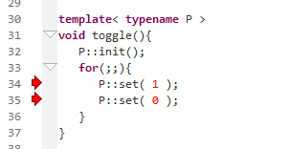
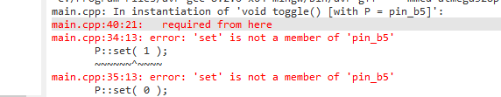
But I didn’t write that &^$&#^* toggle function!
class pin_b5 {
public:
static void write( bool v ){ . . . }
};
template< typename P >
void toggle(){
for(;;){
P::set( 1 );
P::set( 0 );
}
}
int main( void ){
toggle< pin_b5 >();
}

Slide 68
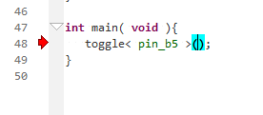
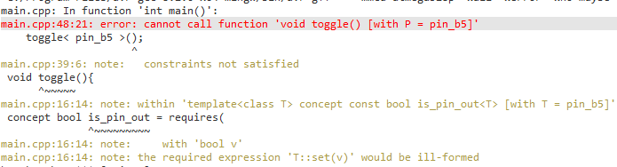
Conepts can rescue your template users
template< typename T >
concept bool is_pin_out = requires( bool v ){
{ T::set( v ) } -> void;
};
class pin_b5 {
public:
static void write( bool v ){ . . . }
};
template< is_pin_out P >
void toggle(){
for(;;){
P::set( 1 );
P::set( 0 );
}
}
int main( void ){
toggle< pin_b5 >();
}

Slide 69
Library concepts

Slide 70
template< typename T >
concept bool is_box = requires {
T::is_box;
{ T::init() } -> void;
};
template< typename T >
concept bool is_input = requires {
is_box< T >;
T::is_input;
{ T::refresh() } -> void;
{ T::read() } -> typename T::value_type;
};
template< typename T >
concept bool is_item = requires {
is_box< T >;
T::is_item;
};
template< typename T >
concept bool is_output = requires (
typename T::value_type v
){
is_box< T >;
T::is_output;
{ T::write( v ) } -> void;
{ T::flush() } -> void;
};
template< typename T >
concept bool is_stream = requires {
is_box< T >;
T::is_stream;
};

Slide 71
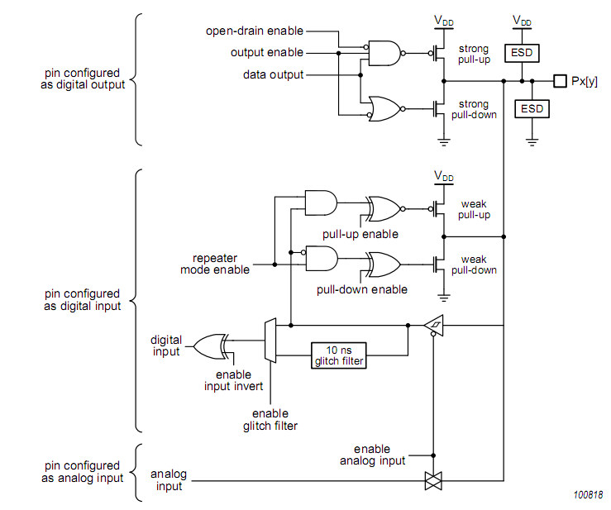
GPIO
Internal circuit

Slide 72
GPIO
Protection

Slide 73
GPIO
Output circuit

Slide 74
GPIO
Input circuit

Slide 75
GPIO
Pull-up / pull-down circuit

Slide 76
GPIO pin: types / modes of use
Input
Output
Input-Output
Open-Collector
( Pull-up, pull-down )

Slide 77
template< typename T >
concept bool is_input_output = requires {
is_input< T >;
is_output< T >;
};
template< typename T >
concept bool is_input = requires {
is_box< T >;
T::is_input;
{ T::refresh() } -> void;
{ T::read() } -> typename T::value_type;
};
template< typename T >
concept bool is_duplex = requires {
is_input_output< T >;
T::is_duplex;
};
template< typename T >
concept bool is_output = requires (
typename T::value_type v
){
is_box< T >;
T::is_output;
{ T::write( v ) } -> void;
{ T::flush() } -> void;
};
template< typename T >
concept bool is_simplex = requires (
){
is_input_output< T >;
T::is_simplex;
{ T::direction_set_input() } -> void;
{ T::direction_set_output() } -> void;
{ T::direction_flush() } -> void;
};

Slide 78
template< typename T >
concept bool is_input_output = requires {
is_input< T >;
is_output< T >;
};
template< typename T >
concept bool is_simplex = requires (
){
is_input_output< T >;
T::is_simplex;
{ T::direction_set_input() } -> void;
{ T::direction_set_output() } -> void;
{ T::direction_flush() } -> void;
};
template< typename T >
concept bool is_duplex = requires {
is_input_output< T >;
T::is_duplex;
};

Slide 79
A GPIO pin
template< _port p, uint32_t pin >
struct pin_in_out : be_pin_in_out {
static void init(){
godafoss::chip_atmega328< clock >::init(); }
static void direction_set_output(){
*port_direction[ (int)p ] |= ( 0x1U << pin ); }
static void direction_set_input(){
*port_direction[ (int)p ] &= ~ ( 0x1U << pin ); }
static void write( bool v ){
if( v ){
*port_data[ (int) p ] |= ( 0x1U << pin );
} else {
*port_data[ (int) p ] &= ~ ( 0x1U << pin );
} }
static void flush(){}
static bool read(){
return ( *port_in[ (int) p ] & ( 0x1U << pin ) ) != 0; }
static void refresh(){}
static void direction_flush(){}
};
template< typename T >
concept bool is_pin_in_out = requires {
is_item< bool >;
is_simplex< bool >;
T::is_pin_in_out;
};

Slide 80
Some GPIO adapters
using pin = target::pin_in_out( . . . );
using pio = pin_in_out< pin >;
using pi = pin_in< pin >;
using po = pin_out< pin >;
using poc = pin_oc< pin >;
using pd = direct< p >;
using pi = invert< d >;
using px = pin_out_from_pins< d >;

Slide 81
Adapter
using pin = target::pin_in_out( . . . );
using po = pin_out< pin >;
template< typename T >
struct box_init_filter {};
template< is_box T >
struct box_init_filter< T > {
static void init(){
T::init();
}
};
template< typename T >
concept bool can_pin_out =
is_pin_in_out< T >
|| is_pin_out< T >
|| is_pin_oc< T >;
template< can_pin_out T >
struct pin_out :
box_init_filter< T >,
box_write_filter< T >
{};
template< is_pin_in_out T >
struct pin_out< T > :
box_write_filter< T >
{
static void init(){
T::init();
direct< T >::direction_set_output();
}
};
template< typename T >
struct box_write_filter {};
template< is_output T >
struct box_write_filter< T > {
using _value_type = typename T::value_type;
static void write( _value_type v ){
T::write( v ); }
static void flush(){
T::flush(); }
};

Slide 82
Decorator
using pin = target::pin_in_out( . . . );
using po = direct< pin >;
template< typename T >
struct _direct_direction : T {};
template< is_simplex T >
struct _direct_direction< T > : T {
static void direction_set_input() {
T::direction_set_input();
T::direction_flush(); }
static void direction_set_output() {
T::direction_set_output();
T::direction_flush();}
};
template< typename T >
struct _direct_read : T {};
template< is_input T >
struct _direct_read< T > : T {
static auto read(){
T::refresh();
return T::read(); }
};
template< typename T >
concept bool can_direct = requires {
is_box< T >;
};
template< can_direct T >
struct direct :
_direct_read<
_direct_write<
_direct_direction < T >>> {};
template< typename T >
struct _direct_write : T {};
template< is_output T >
struct _direct_write< T > : T {
static void write( typename T::value_type v ) {
T::write( v );
T::flush(); }
};

Slide 83
Two wrapper styles
purpose
Coerce to (different) type | Adapter : limits | template< can_pin_out T > struct pin_out : box_init_filter< T >, box_write_filter< T > {};
Modify some semantics | Decorator : preserves | template< can_direct T > struct direct : _direct_read< _direct_write< _direct_direction < T >>> {};

Slide 84
To inline or not to inline
template< typename pin, typename tail >
struct _port_recurse_output : tail {
using _vt = typename tail::value_type;
static void GODAFOSS_INLINE write( _vt v ) {
pin::write( ( v & 0x01 ) != 0 );
tail::write( (_vt) ( v >> 1 ) );
}
static void GODAFOSS_INLINE flush() {
pin::flush();
tail::flush();
}
};
// recursion endpoint
template< int n >
struct _port_out_from_pins< n > :
port_out_dummy< n >
{};
// add one pin and recurse
template< int n, typename pin, typename... tail >
struct _port_out_from_pins< n, pin, tail... > :
_port_recurse_output< pin_out< pin >,
_port_recurse_init< pin_out< pin >,
_port_out_from_pins< n, tail... > > >
{};
// determine the number of arguments, break the forced inlining,
// and defer to the recursive template
template< can_pin_out_list... Ts >
struct port_out< Ts... > :
no_inline<
_port_out_from_pins< sizeof...( Ts ), Ts... > >
{};

Slide 85
no_inline
template< typename T >
struct _no_inline_box_out_wrapper : T {};
template< is_box_out T >
struct _no_inline_box_out_wrapper< T > : T {
using _vt = typename T::value_type;
static void write( _vt v ){
T::write( v );
}
static void flush(){
T::flush();
}
};
template< typename T >
using _no_inline_wrapper =
_no_inline_init_wrapper<
_no_inline_box_out_wrapper<
_no_inline_box_in_wrapper<
_no_inline_box_direction_wrapper<
_no_inline_stream_out_wrapper<
_no_inline_stream_in_wrapper< T > > > > > >;

Slide 86

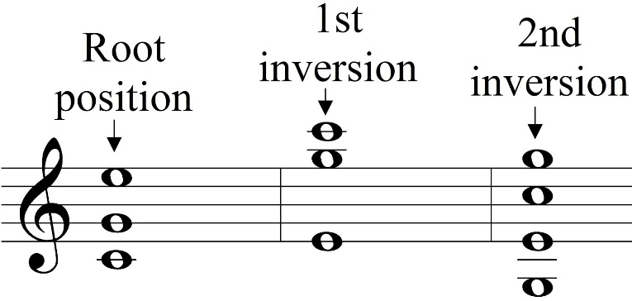


Inversions

Slide 87

Active low
en_pin.write ( 0 ); // enable the chip (pin is active low )
en_pin.write ( 1 );
What do you prefer to read?

Slide 88
My rules
Functions (enable, alarm) are active high
Pins are what the datasheet says

Slide 89
Separate pin from function
auto en_pin = gpio( porta, 12 );
auto enable = invert( en_pin );
enable.write( 1 );
. . .
enable.write( 0 );
using enable = invert< gpio< porta, 12 >>;
enable::write( 1 );
. . .
enable::write( 0 );

Slide 90

Separate pin from function
using spi = gf::spi_bus_bb_sclk_miso_mosi<
target::d12,
target::d13,
target::d9,
timing
>;
using nrf = gf::nrf24l01_spi_ce_csn<
spi,
target::d11,
target::d8,
timing
>;
Use the pin name in a chip-specific interface.

Slide 91
Separate pin from function
template<
typename _bus,
can_pin_out _ce,
can_pin_out _csn,
typename timing
>
struct nrf24l01_spi_ce_csn {
using bus = _bus;
using chip_enable = direct< pin_out< _ce >>;
using chip_select = invert< direct< pin_out< _csn >>>;
. . .
chip_select( 1 );
};
Internally, invert when appropriate.

Slide 92
Separate pin from function
template<
typename _bus,
can_pin_out _ce,
can_pin_out _csn,
typename timing
>
struct nrf24l01_spi_ce_csn {
using bus = _bus;
using chip_enable = direct< pin_out< _ce >>;
using chip_select = invert< direct< pin_out< _csn >>>;
. . .
chip_select( 1 );
};
Internally, invert when appropriate.

Slide 93
SPI

Slide 94


On-PCB communication
I2C : 2 shared wires, slow
SPI : 3 shared + 1 dedicated wire, fast
(Dallas 1-wire, I2S, …)

Slide 95
SPI data transfer

Slide 96

SPI : one byte out, one byte in
template< int bits = 8 >
static void write_and_read_single(
uint8_t d_out,
uint8_t & d_in
){
d_in = 0;
for( uint_fast8_t i = 0; i < bits; ++i ){
mosi::write( ( d_out & ( 0x01 << ( bits - 1 ) ) ) != 0 );
wait_half_period();
sclk::write( 1 );
wait_half_period();
d_out = d_out << 1;
d_in = d_in << 1;
d_in |= ( miso::read() ? 0x01 : 0x00 );
sclk::write( 0 );
}
}

Slide 97
An SPI interface
template< int bits = 8 >
static void write_and_read_single(
uint8_t d_out,
uint8_t & d_in
);
static void write_and_read(
const uint8_t * data_out,
uint8_t * data_in,
uint_fast16_t n
){
uint8_t dummy = 0;
for( uint_fast16_t i = 0; i < n; ++i ){
write_and_read_single(
( data_out != nullptr ) ? data_out[ i ] : dummy,
( data_in != nullptr ) ? data_in[ i ] : dummy
);
}
}

Slide 98
Something for everyone
static void write_and_read(
const uint8_t * data_out,
uint8_t * data_in,
uint_fast16_t n
);
template< unsigned int n >
void write_and_read(
const std::array< uint8_t, n > & data_out,
std::array< uint8_t, n > & data_in,
int_fast16_t amount = n );
void write_and_read(
const uint8_t data_out,
uint8_t & data_in );
template< unsigned int n >
void write(
const std::array< uint8_t, n > & data_out,
int_fast16_t amount = n );
void write( const uint8_t data_out );
template< unsigned int n >
void read(
std::array< uint8_t, n > & data_in,
int_fast16_t amount = n );
void read( uint8_t & data_in );
uint8_t read_byte();
inline!
(flyweight pattern)

Slide 99
RAII
using bus_transfer =
typename bus:: template transfer<
chip_select >;
template< range_1_32 n >
static void read(
const cmd c,
std::array< uint8_t, n > & d,
int_fast16_t amount = n
){
auto t = bus_transfer();
t.write( static_cast< uint8_t>( c ) );
t.read( d, amount );
}
template<
can_pin_out _sclk,
can_pin_in _miso,
can_pin_out _mosi,
typename timing
>
struct spi_bus_bb_sclk_miso_mosi {
template< can_pin_out _sel >
struct transfer {
template< unsigned int n >
void write(
const std::array< uint8_t, n > & data_out,
int_fast16_t amount = n );

Slide 100
buffering

Slide 101


Saving GPIO pins
micro-controller
2 wires I2C (shared!)
micro-controller
pcf8574a
4 + 2 wires
4 + 2 wires
HD44780 LCD
HD44780 LCD

Slide 102
Buffering
static void write( uint_fast8_t d ){
buffer = d;
dirty = true;
}
static void flush(){
if( dirty ){
bus::write_transaction().write( buffer );
dirty = false;
}
}
template< int n > struct pin :
static void write( bool v ) {
if( v ){
chip::buffer |= ( 1 << n );
} else {
chip::buffer &= ~( 1 << n );
}
chip::dirty = true;
}
};
static void write4( uint_fast8_t d ){
port::write( d );
e::write( 1 );
port::flush();
e::flush();
timing::template ns< 500 >::wait();
direct< e >::write( 0 );
}

Slide 103
Char write timing
Hardware | Time to write 1 char
Direct coupled (4-bit) | 217 us
PCF8574A – coupled (4bit) - direct | 3418 us
PCF8574A – coupled (4bit) - buffered | 1453 us
AtMega328 16 MHz
~ 100 KHz bit-banged I2C

Slide 104
Testing

Slide 105
Test ‘framework’
template< typename ostream >
void test_end( ostream & cout ){
if( equal_failures_count == 0 ){
cout
<< "\nTest success: "
<< gf::dec << equal_calls_count
<< " test were successfull\n";
} else {
cout
<< "\nTEST FAILURE: "
<< gf::dec << equal_failures_count
<< " test were NOT successfull\n";
}
}
#define GODAFOSS_TEST_EQUAL( c, a, b ) \
gf_equal( __FILE__, __LINE__, c, #a, #b, a, b );
int equal_calls_count = 0;
int equal_failures_count = 0;
template< typename ostream, typename A, typename B >
void gf_equal(
const char * f, int n, // file name and line number
ostream & cout,
const char * ta, const char *tb, // arguments, stringified
const A & a, const B & b // arguments, as-is
){
++equal_calls_count;
if( a != b ){
++equal_failures_count;
cout
<< f << ":" << gf::dec << n
<< " check failed \n"
<< " GODAFOSS_TEST_EQUAL( " << ta << " , " << tb << " )\n"
<< " left \"" << ta << "\" = " << a << "\n"
<< " right \"" << tb << "\" = " << b << "\n\n";
}
}

Slide 106


Test script
template<
typename _bus,
can_pin_out _ce,
can_pin_out _csn, pin
typename timing
>
struct nrf24l01_spi_ce_csn {
. . .
LUT : NRF24L01
SPI
GPIO
Hardware Abstraction Layer
micro-controller chip
NRF24L01 chip
NRF24L01 chip

Slide 107
Tests
template< typename nrf, typename ostream >
void test( ostream & cout ){
cout << "\nstart single chip tests\n";
nrf::init();
// test SPI interface
// rx_addr_p2 reads back what was written
nrf::write( nrf::reg::rx_addr_p2, 0xAA );
GODAFOSS_TEST_EQUAL( cout, nrf::read( nrf::reg::rx_addr_p2 ), 0xAA );
nrf::write( nrf::reg::rx_addr_p2, 0x55 );
GODAFOSS_TEST_EQUAL( cout, nrf::read( nrf::reg::rx_addr_p2 ), 0x55 );
// writing to another register doesn't influenece rx_addr_p2
nrf::write( nrf::reg::rx_addr_p2, 0x55 );
nrf::write( nrf::reg::rx_addr_p3, 0x00 );
GODAFOSS_TEST_EQUAL( cout, nrf::read( nrf::reg::rx_addr_p2 ), 0x55 );
// cd always reads 0, except for the LSB
nrf::write( nrf::reg::cd, 0x5F );
GODAFOSS_TEST_EQUAL( cout, nrf::read( nrf::reg::cd ) & 0xFE, 0x00 );

Slide 108
(many) More tests
GODAFOSS_TEST_EQUAL( cout, nrf1::transmit_fifo_empty(), true );
GODAFOSS_TEST_EQUAL( cout, nrf2::receive_fifo_empty(), true );
std::array< uint8_t, 10 > tx_data = { 1, 2, 3, 4, 5, 4, 3, 2, 8, 9 };
nrf1::transmit_datagram( tx_data );
GODAFOSS_TEST_EQUAL( cout, nrf1::transmit_fifo_empty(), false );
GODAFOSS_TEST_EQUAL( cout, nrf2::receive_fifo_empty(), true );
test rig only works (reliably) with -18dB power
watch out for inditial-condition-dependence

Slide 109

Demo

Slide 110
Some experiences
Getting abstractions right is difficult
➔ we need more communication
Working with classes (instead of objects) is much easier
Avoid all singletons (and single-typetons)
Documentation tools (Doxygen etc.) are not up to it

Slide 111


Slide 112

Takeaways
C++ has a lot to offer for (small) embedded programming
C++20 even more
Don’t just copy ‘dekstop’-style C_++
Be as specific (limiting) as possible – especially at an interface
Think in small building blocks and composition
Douglas McIlroy

Slide 114
C ➔ C++

Slide 115



Face the opposition: reasons to stick to C
Some good ones
Some debatable ones
Some bad ones

Slide 116
Stick to C : some good reasons
No (good, mandated, … ) C++ compiler available
C is required (by the customer, law, insurance, … )
Your code relies on C features (VLA, sizeof( ‘a’ ), …)

Slide 117
Stick to C : some temporary reasons
large existing C code base
no C++ programmers available
no guidelines, books, courses, etc. for C++

Slide 118
Stick to C : some debatable reasons
C++ is larger, hence code is less easy to read
C++ makes code execution less predictable (debug)

Slide 119

Yes, C++ is large

Slide 120


Development styles
EE / C – style
See what you do – down to assembly
Write quickly, you’ll need the time later on for debugging
The effect is what you observe (UB is just another compiler feature)
If it works, don’t touch it
Big vendor selling points: debuggers, generators
CS / C++ - style
Build and use abstractions that you trust
Write carefully, review, test
The effect is what it should be (no UB allowed)
If the source is not right, correct it (and re-test)
I don’t even have a debugger for any of the chips I use…

Slide 121
Why use C : some bad reasons
C++ is slower
C++ produces larger executables
➔ Use your toolchain appropriately

Slide 122


C ➔ C++ Strategies

Slide 123
Cold Turkey : start a new project in C++ (Dutch: “dood of de gladiolen”)
Get the right people (might be tricky):
Don’t rely on C-style EE’s
Don’t rely on C++-desktop style CS’s.
Fresh students, hobbyists, outside help, …
➔ Don’t feel obliged to use the full language!

Slide 124

C++ features to avoid
(probably) avoid:
RTTI
the heap (free store), hence
exceptions
standard containers (except std::array<>)
floating point

Slide 125
Salami technique : small steps first (world domination has to wait)
Low-impact (don’t disturb the C-culture too much)
Medium-impact (expect some resistance..)
OO (familiar to non-embedded C++ programmers)
Modern (keep an expert nearby)

Slide 126

Low-impact C++ features
const correctness
binary literals
’ separator in literals
namespaces
enum class
by-reference parameters
constexpr
if constexpr

Slide 127
Medium-impact C++ features
Overloading
Default parameters
Transparent Data Types
Abstract Data Types (private)

Slide 128
OO C++ features
basic OO: interface, with different implementations
decorators / adapters (run-time composition)
for( : )
auto
} (destructors)

Slide 129

Modern C++ features
Templated interfaces
Concepts
Domain Specific Languages
Compile-time composition (CRTP)
Real Magic (Louis, Odin, Chiel, …)

Slide 130
OO: a class is just a struct
class xy {
public:
int x, y;
xy( int x, int y ): x( x ), y( y ){}
xy add( xy rhs ){
return xy( x + rhs.x, y + rhs.y );
}
};
auto a = xy( 1, 2 );
auto b = xy( 3, 4 );
auto c = a.add( b );
struct xy {
int x, y;
};
xy add( xy * this_, xy rhs ){
return xy{
this_->x + rhs.x,
this_->y + rhs.y };
}
xy a{ 1, 2 };
xy b{ 3, 4 };
xy c = add( &a, b );

Slide 131
OO: virtuals are just function pointers
struct xy_functions;
struct xy {
int x, y;
const xy_functions *vft;
xy( int x, int y, const xy_functions *vft ):
x( x ), y( y ), vft( vft ){}
};
struct xy_functions {
void (*print)( xy * );
};
void my_xy_print( xy * this_){
std::cout<< "[" << this_->x << "," << this_->y << "]";
};
const xy_functions my_xy_vft = { my_xy_print };
struct my_xy : xy {
my_xy( int x, int y ): xy( x, y, & my_xy_vft ){}
};
void f(){
auto a = my_xy( 42, 84 );
(( xy_functions * ) a.vft )->print( & a );
}
class xy {
public:
int x, y;
xy( int x, int y ): x( x ), y( y ){}
virtual void print() = 0;
};
class my_xy : public xy {
public:
my_xy( int x, int y ): xy( x, y ){}
void print() override {
std::cout << "[" << x << "," << y << "]"; }
};
void f(){
auto a = my_xy( 1, 2 );
a.print();
}

Slide 132
Q1
Programming (Python)
Computer systems & networks
ICT and organization
Q2
Modelling (BPMN, use-cases, databases)
ASK (Critical thinking, logics, statistics)
Group project (collaboration, agile, professional skills)
Q3
procedural programming (algorithmics, C++)
operating systems (Linux, RaPi)
Lego Robotics (Lego + BrickPi, C++)
Q4
OO programming and micro-controllers (classic C++, ArduinoDue)
Digital and analog electronics, computer architecture
1st year final project (individual, ArduinoDue, C++)

Slide 133
Q5
Low-level programming (assembly, C++, threading)
Real-time modelling (UML & synchronization)
Laser-Tag project (RTOS, modelling, waterfall, C++)
Q6
High-level programming (C++, resources, STL, patterns, SFML)
Datastructures & algorithms (lists, trees, hashmaps; Python)
Game project (SFML, PC/Linux/Mac, Agile/scrum, C++)
Q7
MRB (sensors, actuators, control)
Vision (image processing)
Development department: large group, proposals, dependencies
continuous integration, tests, changing requirements, self-organizing,
scrum
Q8
Research
Development department cont. – 15 EC total

Slide 134
Resources for micro-controller development:
Cross-toolchain (compiler & linker)
Language library & runtime (standalone subset…)
Chip headers
Chip startup code
Chip linker script
Download tool
Download hardware
Target system

Slide 135
What I use / provide
Cross-toolchain
Language library & runtime
Chip headers
Chip startup code
Chip linker script
Download tool
Download hardware
Target system
Hwlib
GCC
bmptk
www.github.com/wovo/bmptk
Arduino Due

